Slide 1
A tutorial of Hidden Markov Model (HMM)
Nov. 2015
Qiuqiang Kong
q.kong@qmul.ac.uk

Slide 2
Application of HMM
Stock price analysis
Auto speech recognition
Character recognition
Sequence alignment
etc.

Slide 3
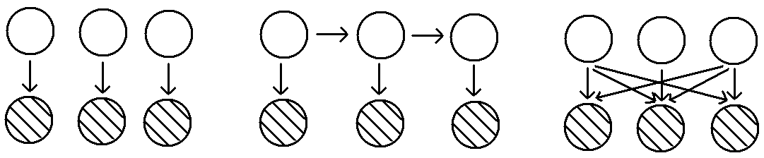
Probabilistic Graphical Model (PGM)
PGM is a probabilistic model. The graph expresses the conditional dependence structure between random variables.
Example:
GMM
HMM
Others
White circle represents latent variable.
Solid circle represents observed variable.
All of GMM, HMM, Others belongs to PGM.

Slide 4
EM algorithm for PGM
EM algorithm is used to estimate parameters in probabilistic graphic model (PGM) with latent variables*.
EM algorithm for PGM with latent variables
1. Init parameters
2. E step: q(Z)=p(Z|Xθ^{old})
3. M step:
where
4. If converge then stop, otherwise goto 2
* More details can be seen in GMM Tutorial.

Slide 5
Generally, estimation of p(Z|Xθ^{old}) is difficult.
However, the independence of PGM will simplify the model.
D-separation property^{[1]}
Let A, B, C be set of nodes. We can check whether A and B are conditional independent on C in belowing way.
Check all the paths from node in A to node C. The path is said to be blocked if
∃ head-to-tail or tail-to-tail nodes on the path, and the node is in C.
∀ head-to-head nodes, neither the node, nor any of its descendants is in C
If all paths are blocked, then A is said to be d-separated from B by C.
That is P(AB|C) = P(A|C)P(B|C).
[1] Bishop, Christopher M. Pattern recognition and machine learning. springer, 2006. Chap. 8.

Slide 6
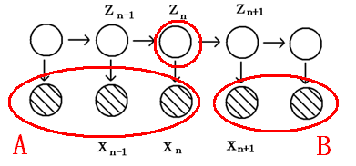
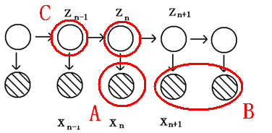
Exercises

Slide 7
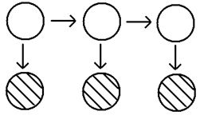
HMM model
Hidden Markov Model (HMM) is a kind of PGM with latent variables.
HMM
HMM’s joint probability distribution over both latent and observed variables is
(1)
where the parameters are
π is the start probability of each state.
A is the transition matrix.
φ is the parameter associated with emission distribution (can be multinominal, Gauss, GMM, etc. )

Slide 8
Three basic problem of HMM
How to train a HMM model?
Given a sequence X, how to get the likelihood p(X) from HMM model?
How to find the best decoding path of HMM model?

Slide 9
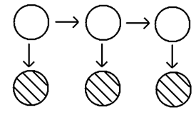
How to train HMM model?
HMM is a kind of probabilistic graphic model (PGM) with latent variables.
Apply EM algorithm to HMM, Q(θ,θ^{old}) is
HMM
(2)
①
②
③
Where
(3)
(4)
π is only associated with ①
A is only associated with ②
φ is only associated with ③

Slide 10
E step
Evaluate p(Z|Xθ^{old}).
From the form of Q(θ, θ^{old}) of HMM, there is no need to calculate p(Z|Xθ^{old}) for all Z. Many terms vanish. So just need to calculate
Generally, p(Z|Xθ^{old}) is difficult to estimate in PGM. While using dependency of HMM, we can simplify the computation.
We will show γ(z_{nk}) can be decomposed to forward and backward term.
(5)
forward
backward
Both of forward and backward term can be computed efficiently.

Slide 11
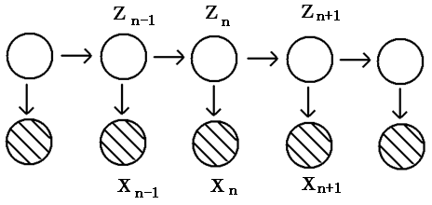
Forward Backward algorithm
Using independence of PGM, we can decompose
into forward and backward term.
HMM
(6)
where
(Forward)
(7)
(Backward)
(8)

Slide 12
Compute
Can be computed efficiently using dependency of HMM
denote
(9)
(10)
HMM
(11)

Slide 13
where
(12)
(integrate both side of (11) )
(13)
*Byproduct: the likelihood of a sequence X:
(14)
Compute
(15)
where
(16)

Slide 14
Compute
Using conditional dependency of HMM
HMM
(17)

Slide 15
M step
In M step, need to optimize Q(θ,θ^{old}) with respect to θ = {π, A, φ}
(18)
①
②
③
π is only associated with ①
A is only associated with ②
φ is only associated with ③
π, A, φ are independent, so they can be optimized respectively.

Slide 16
①
maximize π
Take constraint
into consideration, introduce Lagrange function
(19)
Let
(20)
②
maximize A
Take constraint
into consideration, introduce Lagrange function
(21)
Let
(22)
This shows the elements which are zero in A_{jk} will keep zero all the time.
So it you want to get left-right HMM just initialize A as upper diagonal matrix.

Slide 17
③
Maximize φ
the emission distribution can be multinominal, Gaussian, etc. We will discuss separately.
Ⅰ.
Emission distribtution is discrete multinominal distribution
probability density function
(23)
where
B_{km} represents the probability of m-th event at k-th state.
To estimate B_{km}, introduce Lagarange function
(24)
(25)

Slide 18
EM algorithm for multinominal-HMM
1. Init parameters
where
2. E step
Calculate
using (6)
Calculate
using (17)
3. M step
4. If converge then stop, otherwise goto 2.

Slide 19
Example
Generate Multinominal-HMM for belowing sequences
Data{1} = [1 1 1 4 1 1 1 2 2 2 2 2 2 1 2 2 2 2 3 3 3 3 3 1 3 3 3]
Data{2} = [1 1 2 1 1 1 1 1 2 2 2 3 2 2 2 2 2 3 3 3 3 3 4 3 3 3]
State num: 3, multinominal num: 4
Output
π = [1, 0, 0]
A = [ 0.87, 0.13, 0,00
0.00, 0.90, 0.10
0.00, 0.00, 0.10]
B = [ 0.85, 0.06, 0.05
0.08, 0.89, 0.00
0.00, 0.05, 0.89
0.07, 0.00, 0.06 ]

Slide 20
Ⅱ. Emission distribution is Gaussian distribution
probability density function
(26)
where
Define
(27)
To estimate parameters, let derivative of (27) with respect to
be zero
(28)

Slide 21
EM algorithm for Gaussian-HMM
1. Init parameters
where
2. E step
Calculate
using (6)
Calculate
using (17)
3. M step
4. If converge then stop, otherwise goto 2.

Slide 22
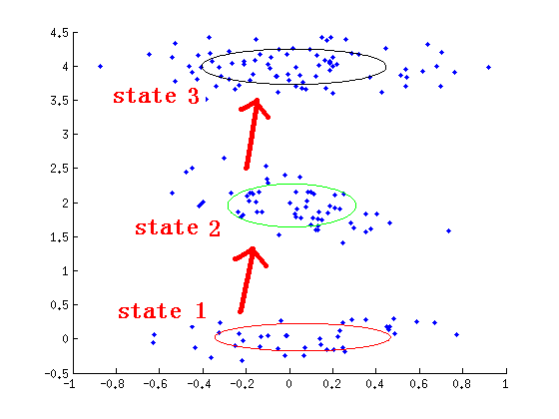
Example
The graph below shows the trained Gaussian-HMM model using created data.
State num: 3
π = [1, 0, 0]
A = [0.95, 0.05, 0.00
0.00, 0.97, 0.03
0.00, 0.00, 1.00 ]
is shown in graph

Slide 23
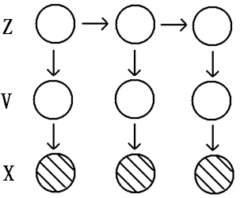
GMM-HMM
Gaussian distribution is not able to capture distributions with many centers. Especially in ASR, where the timbre differentiates from person to person.
In GMM-HMM, every single state is a GMM model.
Define v as 1-of-K*M random variable, where K is the number of state. M is the mixture number of GMM.
v_{km}=1 represents the k-th state, m-th mixture occurs.
GMM-HMM
Parameters are
where
is the probability of m-th mixture under k-th state
is mean and covariance of the k-th state, m-mixture, respectively.
Probability density function
(29)

Slide 24
Apply EM algorithm to GMM-HMM
Compared with GMM-HMM, there are other latent variables v_{n}, which dominates the emission GMM
denote
(30)
Using independence of GMM-HMM, calculate Q(θ,θ^{old})
GMM-HMM
(31)
①
②
③

Slide 25
E step
Calculate
From (31), no need to calculate all
, only the terms below is needed
(32)
(33)
(34)
(32), (33) can be calculated in same way as (6), (17)
To calculate (34), just use forward-backward algorithm similar to (6)
(35)
forward
backward
where
(36)
(37)

Slide 26
denote
can be computed similar to (10) – (16)
Results are given without detailed deduction
(38)
(39)
(40)
(41)
(42)
(43)

Slide 27
M step
Maximize π, A
The maximization of π, A is same as (20), (22).
(44)
(45)
Maximize φ
To maximize
Taking constraint
into account
Introduce Lagrange function
(46)

Slide 28
Let the derivative of
With respect to
be zero
(47)

Slide 29
EM algorithm for GMM-HMM
1. Init parameters
where
2. E step
Calculate
,
,
from (32), (33), (34)
3. M step
4. If converge then stop, otherwise goto 2.

Slide 30
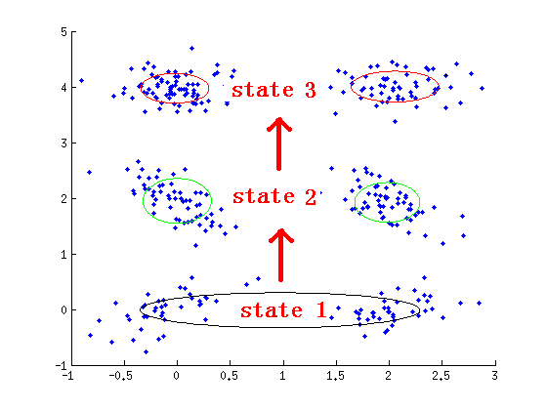
Example
A GMM-HMM with state num:3, mix num:2
π: [0, 0, 1]
is shown on the graph
A: [ 1.00, 0.00, 0.00,
0.03, 0.97, 0.00,
0.00, 0.05, 0.95 ]

Slide 31
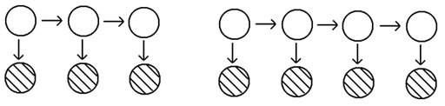
Multi Sequence Training
Till now, we train HMM only use one sequence.
In ASR, we have many utterance to train one HMM model for each phoneme / word.
This part will show how to train HMM using multi sequences.
Seq⁽¹⁾
Seq^{(R)}
Using independency of PGM, Q(θ,θ^{old})
(48)
Where X^{(r)} is the observation variables of r-th seq.
Z^{(r)} is the latent variables of r-th seq.

Slide 32
E STEP
Estimate γ, ξ, η for each sequences separately.
(49)
(50)
(for GMM only)
(51)
M STEP
Optimize (48) with respect to θ = {π, A, φ}
(52)
(53)

Slide 33
Ⅰ. Multinominal Distribution
(54)
Ⅱ. Gauss Distribution
(55)
Ⅲ. GMM
(56)

Slide 34
Decoding of HMM
Q: How to find the best decoding path?
A:
(57)
However, we need to evaluate all possible Z which is K^{N} times to get accurate solution. This infeasible.

Slide 35

Viterbi Algorithm
Use greedy algorithm to estimate optimized path step by step.
By discarding paths with low probability and storing previous step, the computation complexity decreased to K*N
Viterbi Algorithm
Path stored

Slide 36
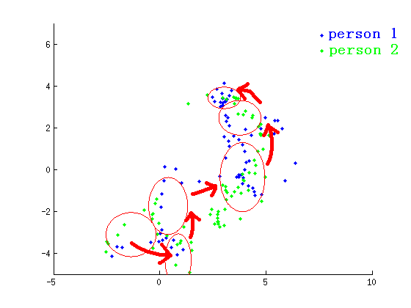
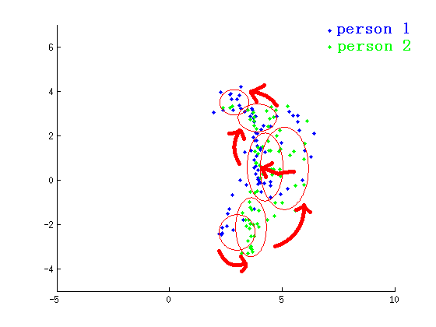
Experiments in small vocabulary ASR
12 Mfcc feature (only choose the 1st and 2nd dimension to plot)
1. Gaussian-HMM, state num: 6
“kaimen”
“guanmen”
π = [1, 0, 0, 0, 0, 0]
π = [1, 0, 0, 0, 0, 0]
A =
0.86 | 0.14 | 0 | 0 | 0 | 0
0 | 0.90 | 0.10 | 0 | 0 | 0
0 | 0 | 0.87 | 0.13 | 0 | 0
0 | 0 | 0 | 0.97 | 0.03 | 0
0 | 0 | 0 | 0 | 0.91 | 0.09
0 | 0 | 0 | 0 | 0 | 1.00
A =
0.89 | 0.11 | 0 | 0 | 0 | 0
0 | 0.87 | 0.13 | 0 | 0 | 0
0 | 0 | 0.77 | 0.23 | 0 | 0
0 | 0 | 0 | 0.97 | 0.03 | 0
0 | 0 | 0 | 0 | 0.95 | 0.05
0 | 0 | 0 | 0 | 0 | 1.00

Slide 37
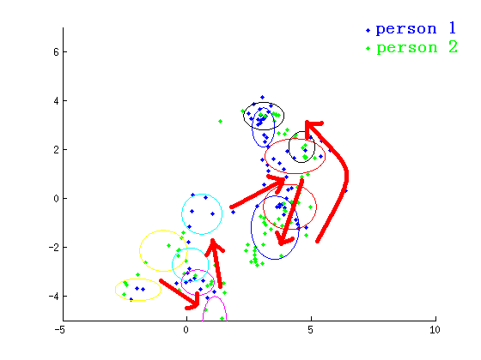
2. GMM-HMM (6 states, 2 mixutre)
With the increase of dataset, Gaussian-HMM is not able to capture the timbre of different people, gender, age.
We can use GMM-HMM model instead.
“kaimen”
However, GMM-HMM is sensitive to the initial parameters. The tricks we are using in this example is:
Use Gaussian-HMM to train different people separately.
Combine the data point which are in the same state. Use GMM to initialize the parameters.
Run GMM-HMM to fine-tune the model.

Slide 38
Results
Dataset: 20 Isolated Chinese words. 11 male + 9male. Altogether 800 pronunciations.
10 male and 9 female for training. 10 male and 10 female for testing.
Feature: 12 dimension MFCC
Model: Gaussian-HMM, GMM-HMM
Model | Accuracy
Gaussian-HMM | 82.25%
GMM-HMM | 84.00%

Slide 39
Weakness of HMM
1. Markov assumption
The next state is only dependent upon the current state. So is poor at capturing long-range correlations between the observed variables.
(58)
2. Stationary assumption
(59)
3. Output independence assumption
The current output is conditionally independent of the previous output.
(60)

Slide 40
Tricks of HMM
1. HMM is more sensitive to the initial parameters than GMM. So it is easy to get into local minimum.
Solve: Use GMM or other methods to initialize parameters.
Initialize parameters randomly and run HMM separately for several times.
2. For Gaussian-HMM & GMM-HMM, if eig(Σ) is too small. Then Σ⁻¹ will be unstable.
Solve: if eig(Σ) < ε then Σ = Σ + σI

Slide 41
3. If p(x|z) is Gaussian or GMM pdf, underflow may occurs.
if this term is too small,
after exp it will underflow
Solve: use ln p(x|z) to instead p(x|z) in code implementation.
For Gaussian
For GMM
if this term is too small,
after exp it will underflow
Normalization factor,
To avoid underflow

Slide 42
4. According to (11), (15),
may underflow, and
will be unstable
Solve: Use
replace
if this term is too small,
after exp it will underflow
Normalization factor,
To avoid underflow
The same strategy can be applied to
will turn to

Slide 43
Furthermore, for parameter estimation, such as (28) will turn to
if this term is too small,
after exp it will underflow
Normalization factor,
To avoid underflow

Slide 44
Matlab Code
https://github.com/qiuqiangkong/matlab-hmm

Slide 45
THANK YOU!

